Slide 1

Automobile Theft Crime Analysis
Group 07 Project Report
Princely Jonas Lopes
Thinh Huynh
Zahira Ghazali
Saloni Sandip Ingle

Slide 2

Introduction
Predictive policing, an emerging approach in law enforcement, utilizes data analysis and machine learning algorithms to forecast criminal activity.
Eliminate the period of time between the occurrence of a crime and law enforcement being on site to deal with the crime.
We are focusing on creating data analytics to implement predictive policing for automobile related crime

Slide 3

Procedures
Collected 2 datasets from Oakland and Los Angeles
Perform necessary data cleaning and feature engineering
Extracting important analysis from the dataset
Visualization of the analysis
Perform Feature Engineering
Perform Models Selection and Models Training
Visualize the Prediction Result

Slide 4
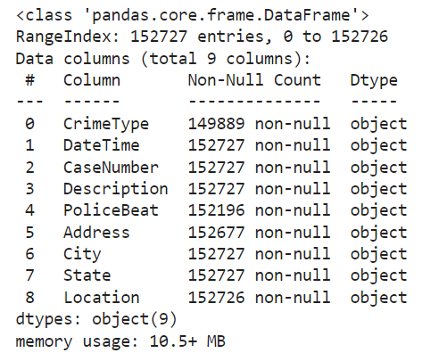
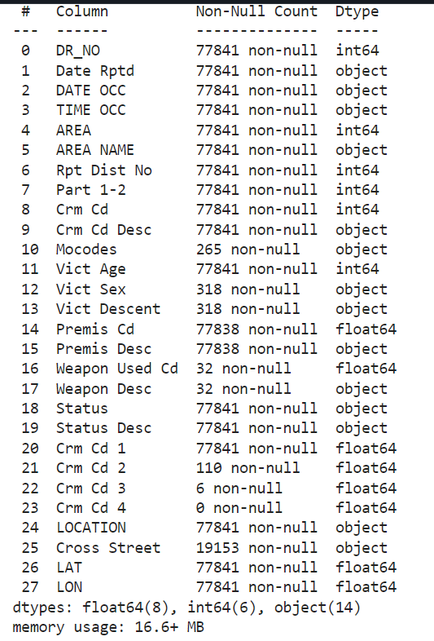
Datasets
Original Oakland Dataset Info
Original Los Angeles Dataset Info

Slide 5
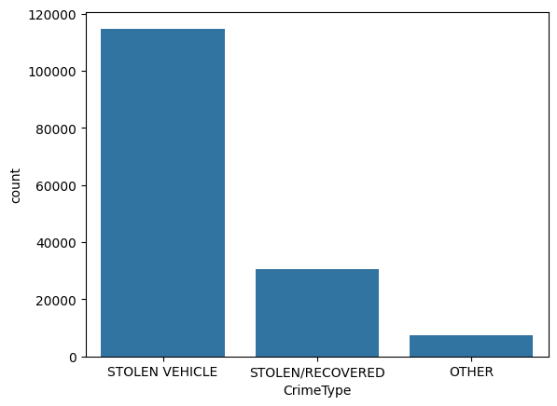
Oakland Data Analysis
Type of Crimes

Slide 6
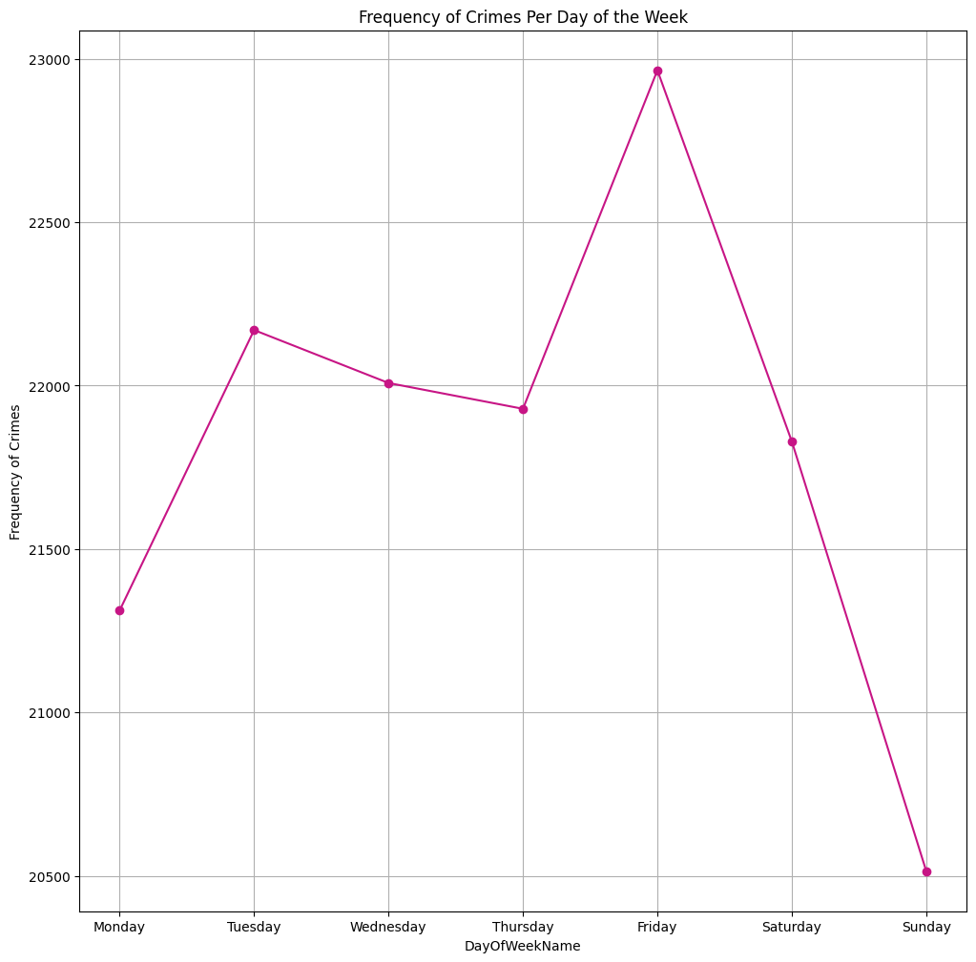
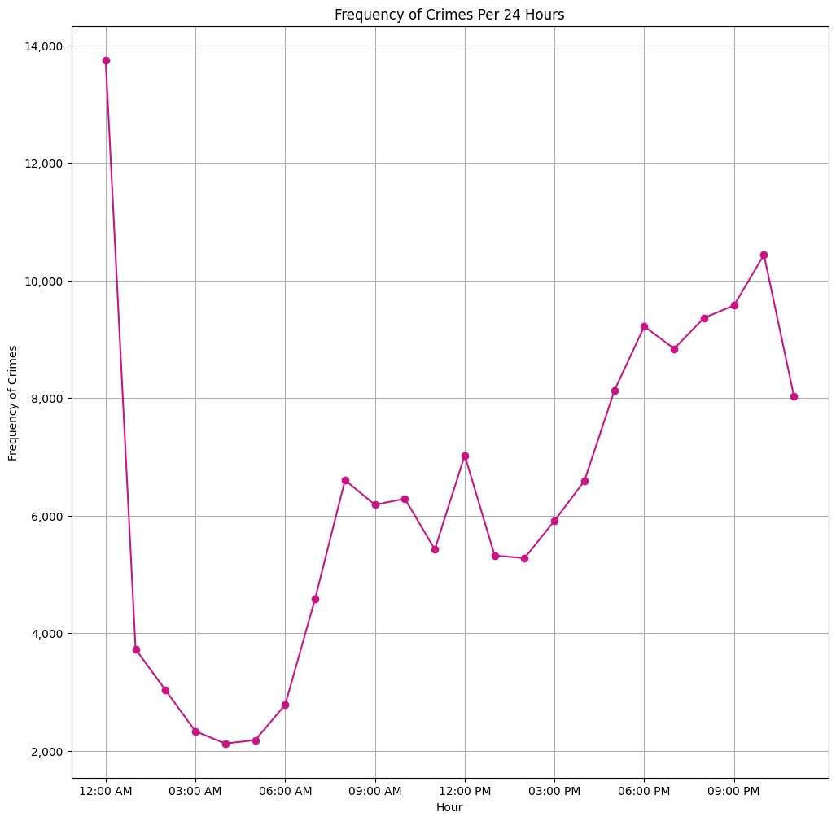

Slide 7
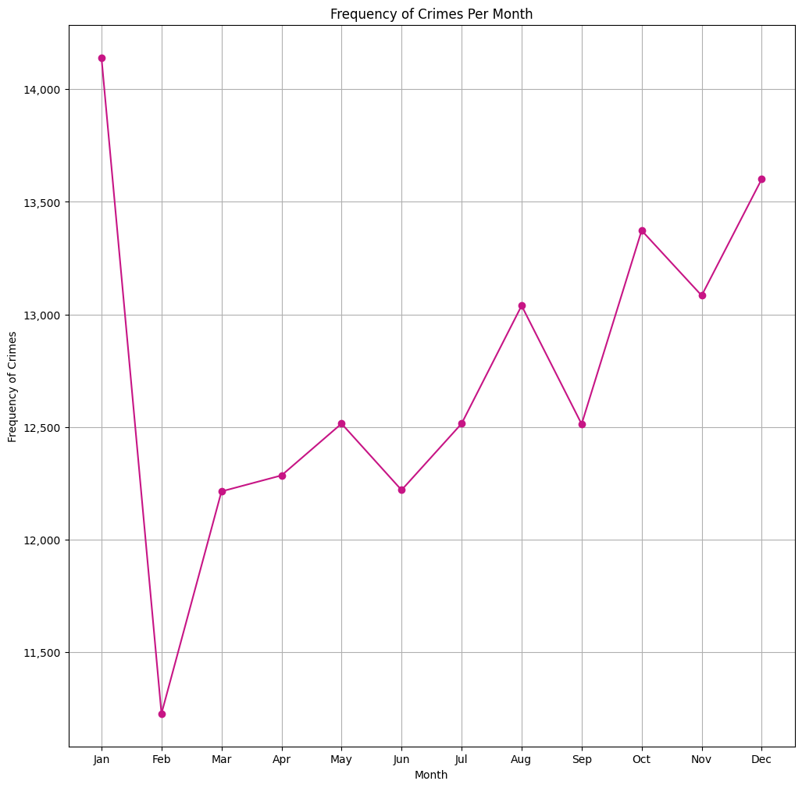
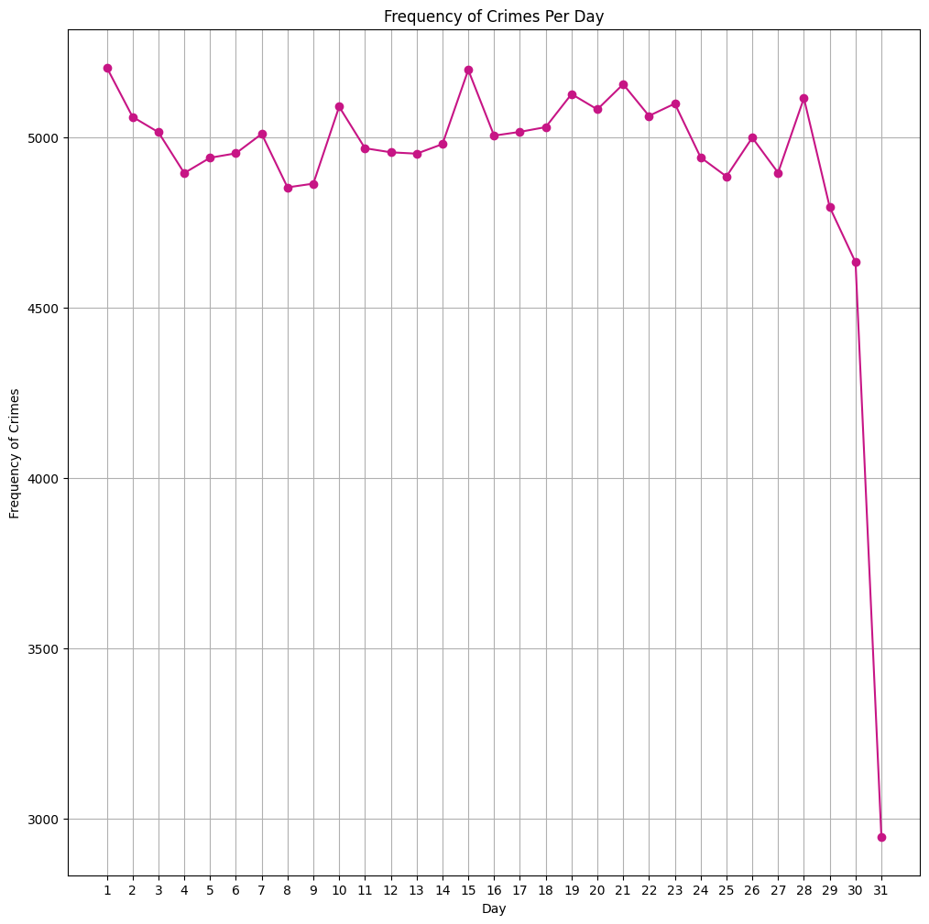

Slide 8
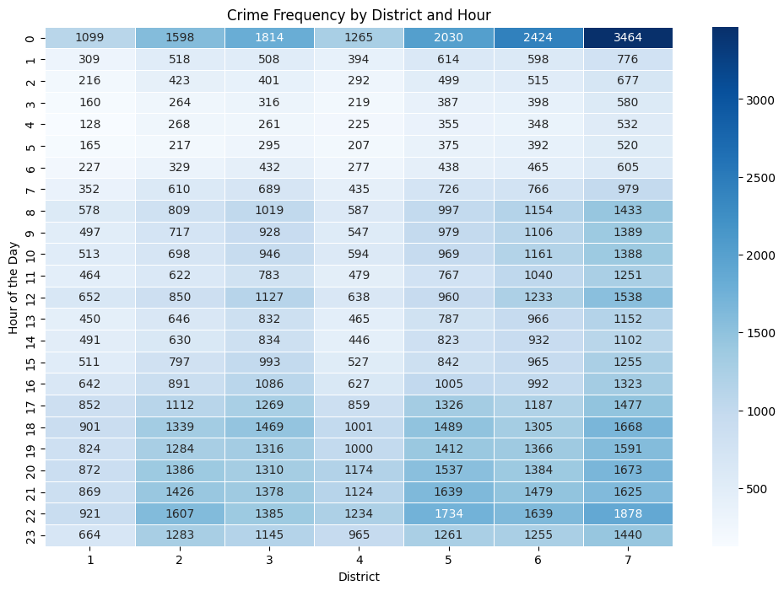
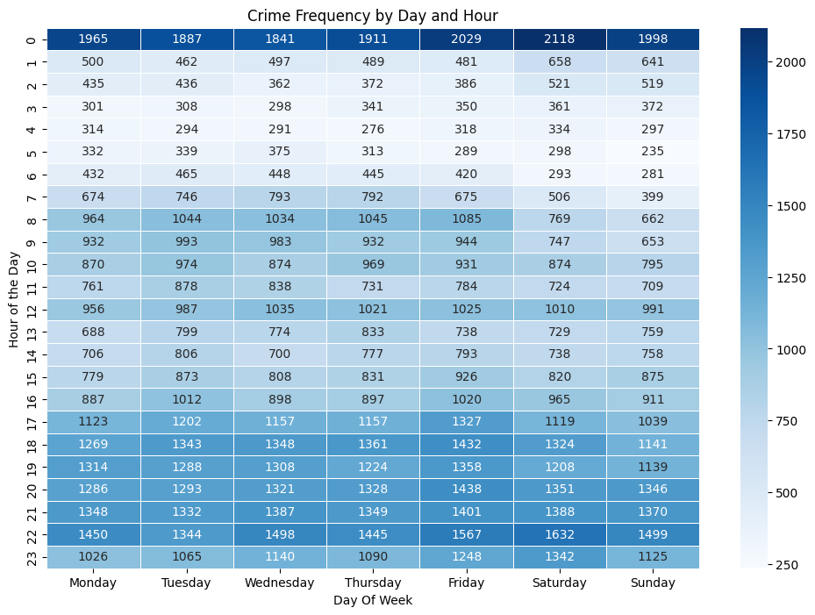
Heatmap

Slide 9
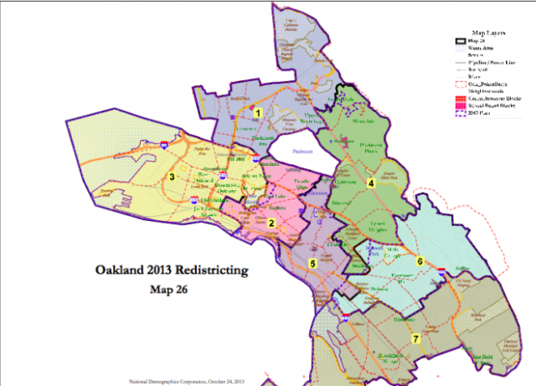
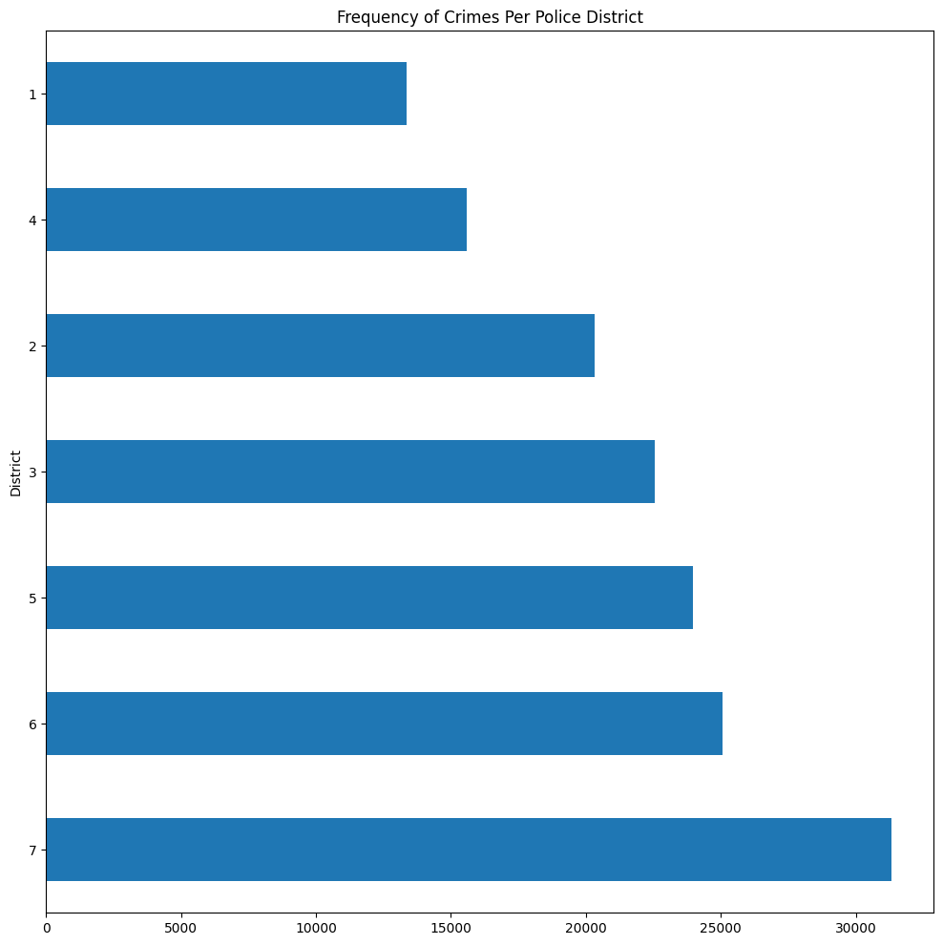
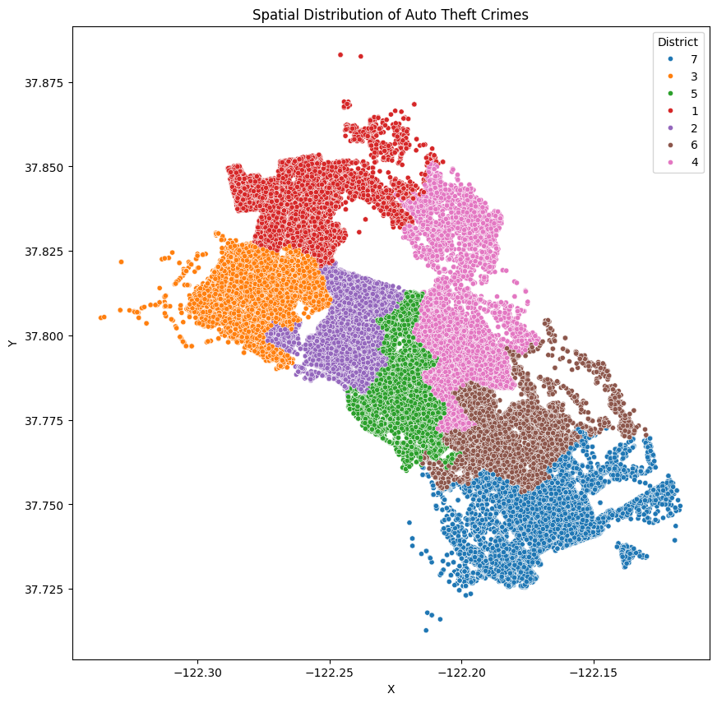
Oakland Districts

Slide 10
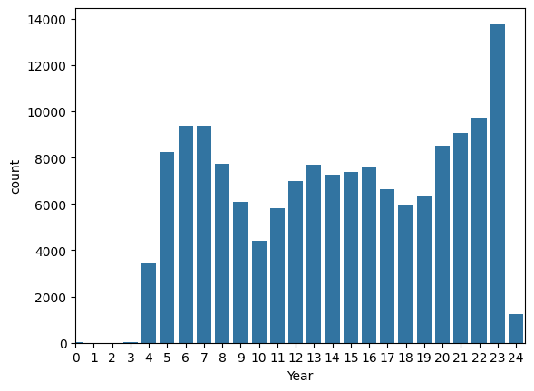

Slide 11
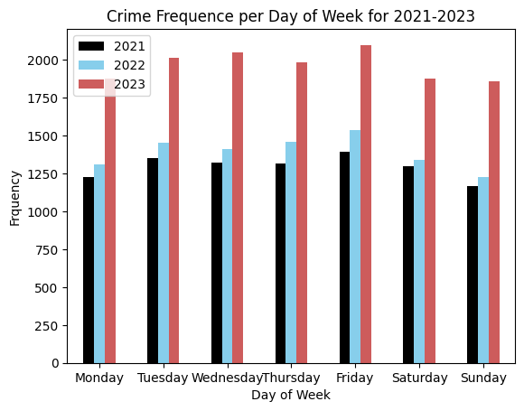
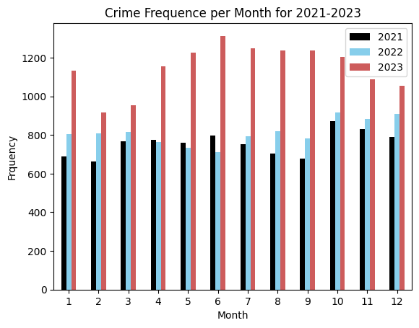
Oakland Crimes Comparison (2021-2023)

Slide 12
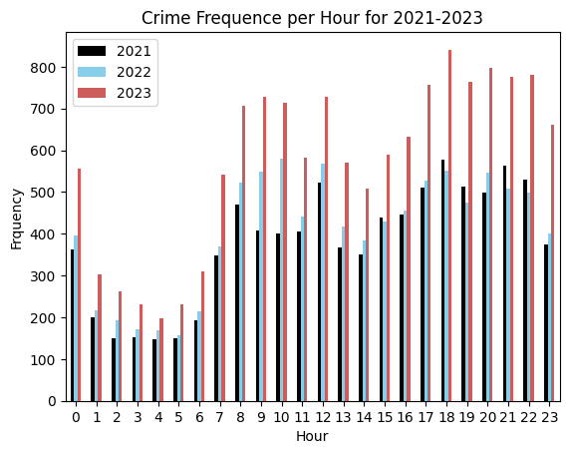
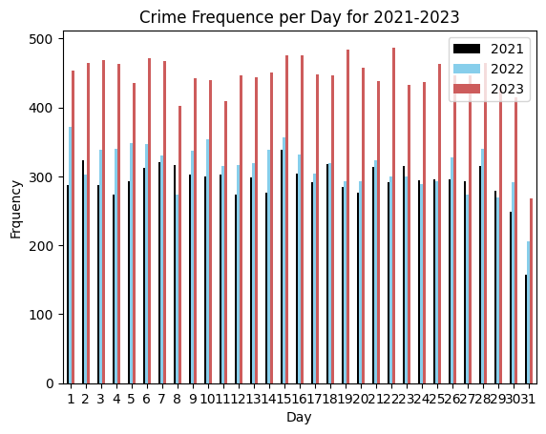

Slide 13
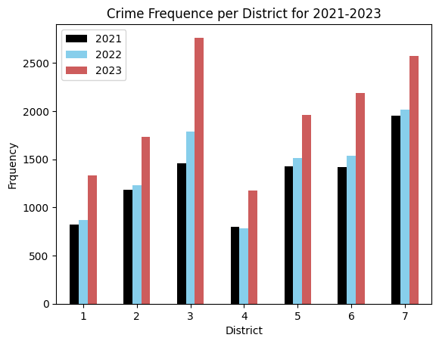

Slide 14

Oakland Observation
Observable Trends:
Auto theft crime rate slowly rise during weekday and peak on Friday, come back down on weekend
Peak auto theft crime rate around nightly hour and midnight
High auto theft crime rate during holiday months and end of the year
No significant spike in auto theft crime rate throughout each day of the month
Highest auto theft crime rate in district 7 (Downtown Oakland)
Auto theft crime rate spike in 2023 probably because lockdown from COVID 19 got lifted.

Slide 15
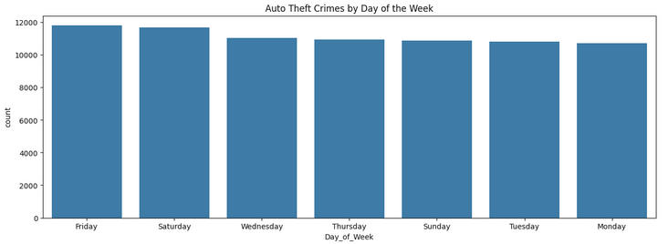
Los Angeles Data Analysis

Slide 16
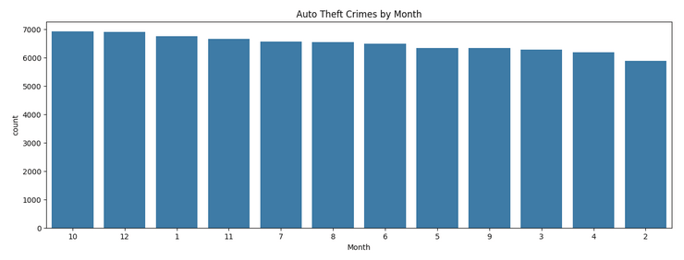

Slide 17
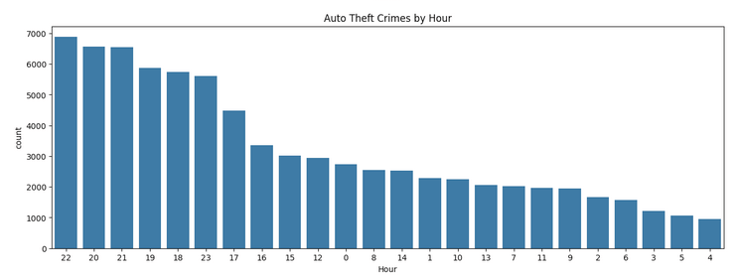

Slide 18
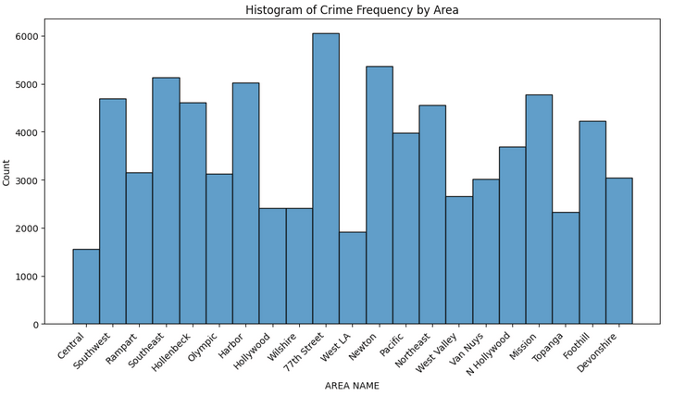

Slide 19
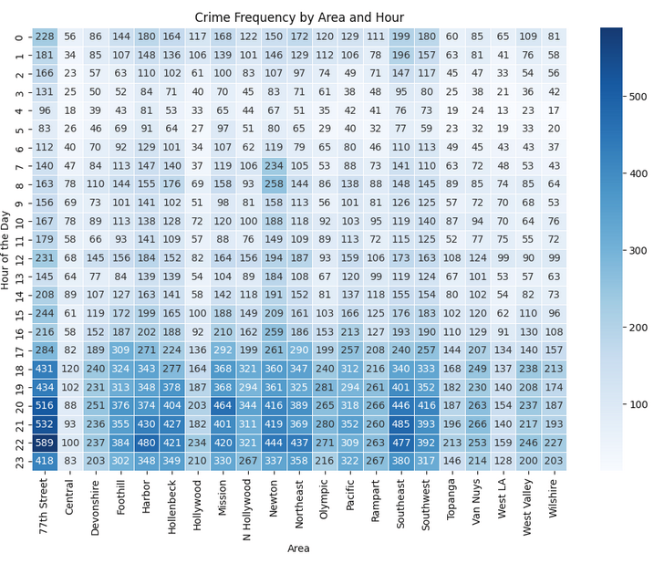
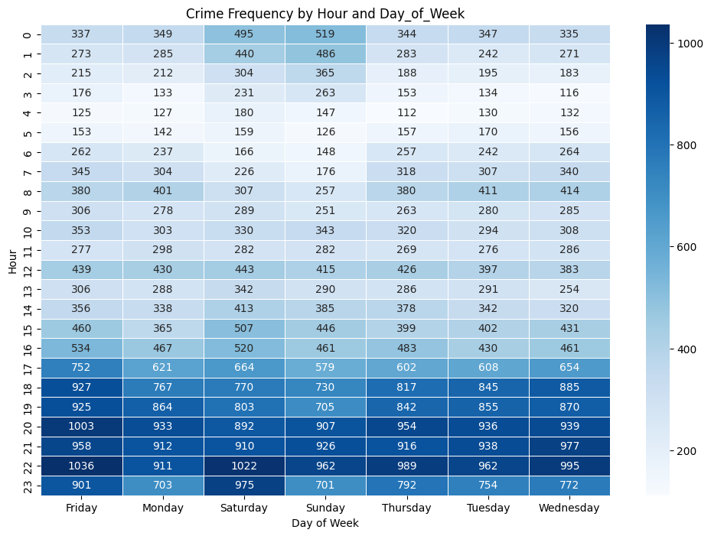
Los Angeles Heatmap

Slide 20
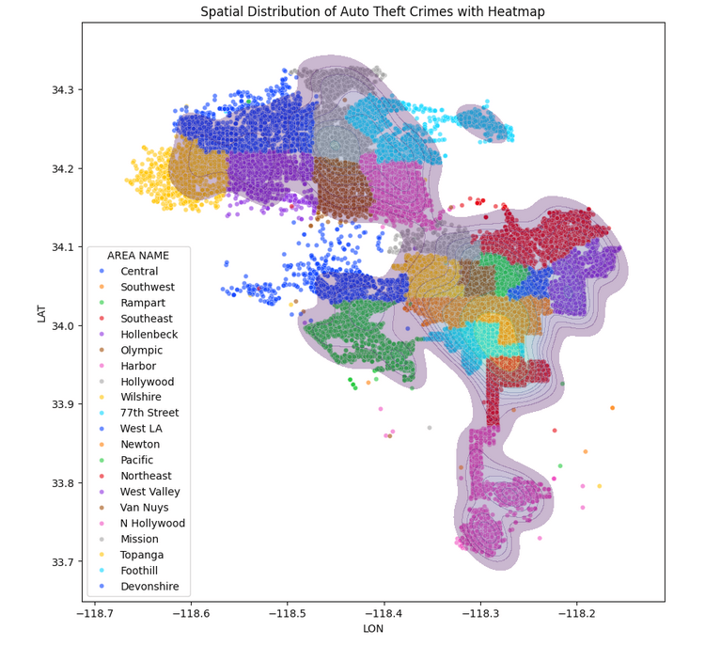

Slide 21

Los Angeles Observation
Trends:
Constant auto crime rates by Day of the Week and Month unlike the pattern in Oakland
Similar to Oakland’s pattern, Los Angeles auto crime rate is very high at night
77th Street has the highest auto theft crime rate among all the area

Slide 22
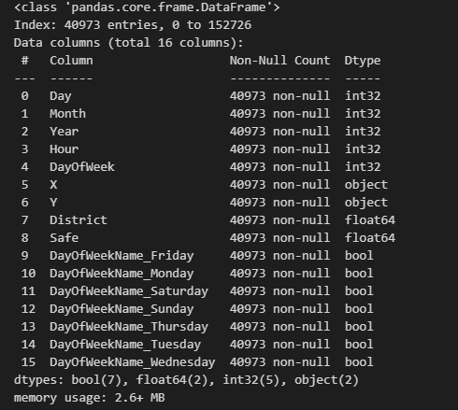
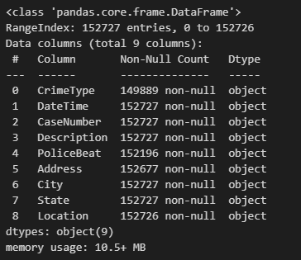
Feature Engineering
New Features
Original Features

Slide 23
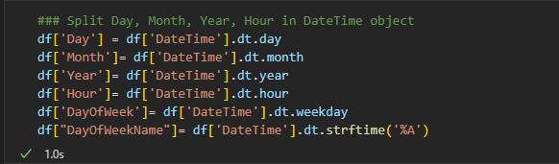
Feature Engineering (cont.)
Day/ Month/ Year/Hour/DayOfWeek/: generated from the DateTime feature from the original dataset

Slide 24
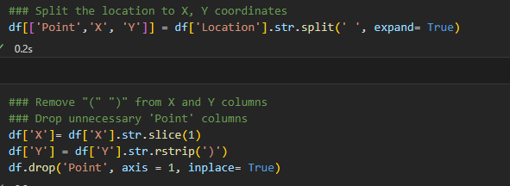
Feature Engineering (cont.)
X and Y Coordinate: generate from the Location feature from the original dataset

Slide 25
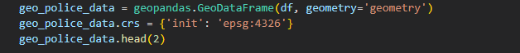
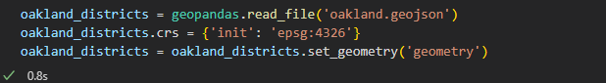
Feature Engineering (cont.)
Districts feature: generated based on the (X,Y) geometry coordinate, using GeoPandas and Oakland GeoJson (available online)

Slide 26
Feature Engineering (cont)
Safe Feature: generate based on the occurrence of crime using the frequency of Month, Day, Hour and Districts (screenshot next slide)

Slide 27
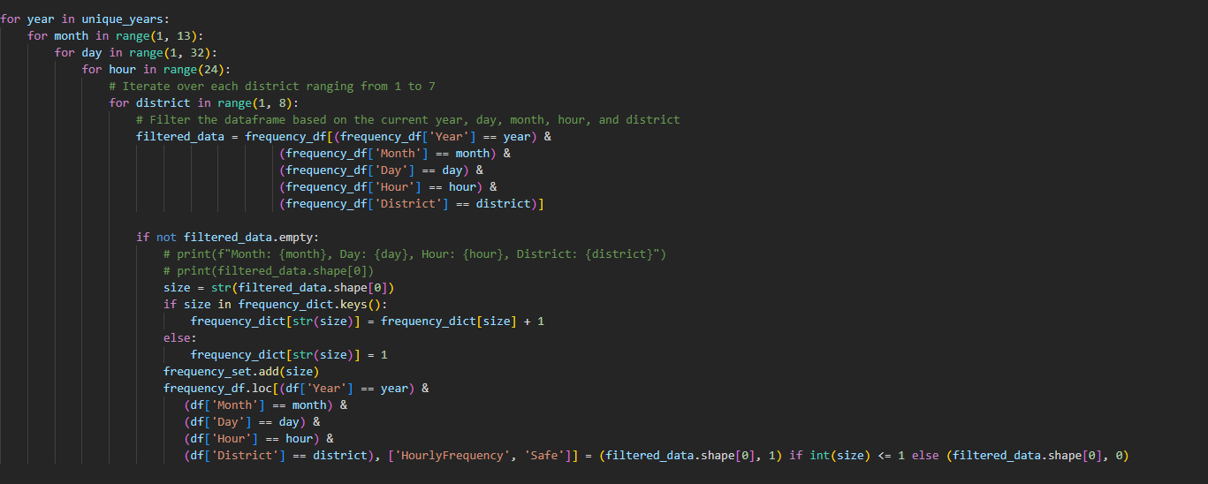

Slide 28
Models Selection
8 models were chosen to predict our Oakland dataset
Gaussian Naive Bayesian
Multi-Layer Perceptron Classifier
Random Forest Classifier
Logistic Regression
Support Vector Classification
Decision Tree
AdaBoost Classifier
Stochastic Gradient Descent

Slide 29
Model Training & Hyperparameter Fine Tuning
Out of the 8 models:
6 models were running on default parameter settings
Gaussian and Random Forest was running on fine-tuning parameter using GridSearchCV
Unfortunately, fine-tuning the hyperparameters takes some time and computer resources

Slide 30
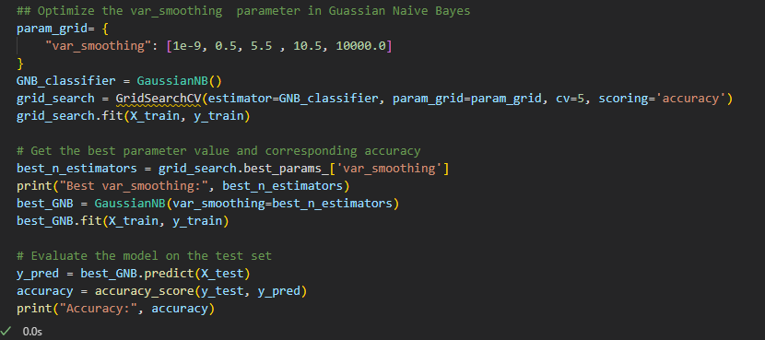
Gaussian Fine-Tuning

Slide 31
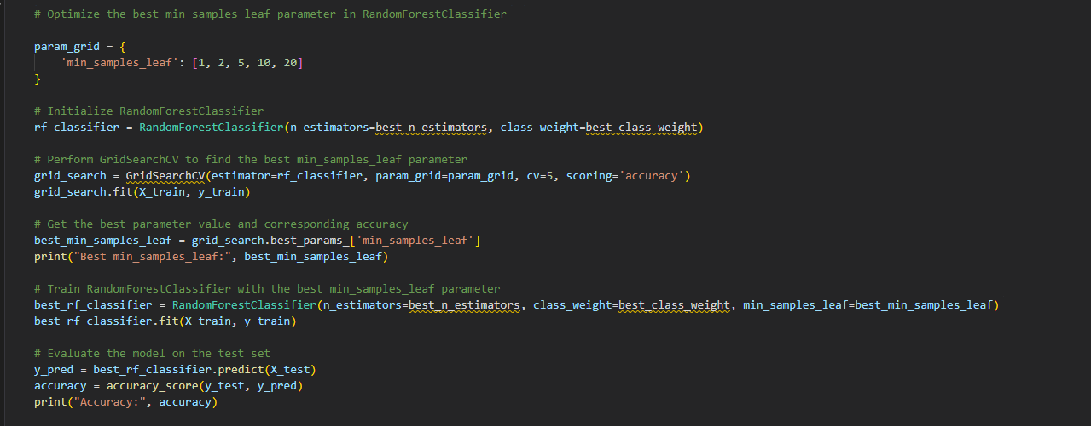
Random Forest Fine-tuning

Slide 32
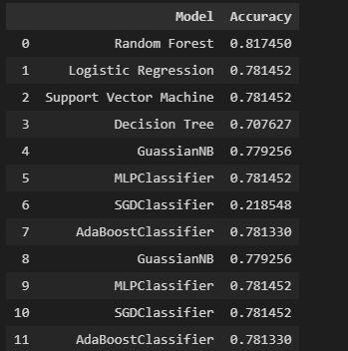
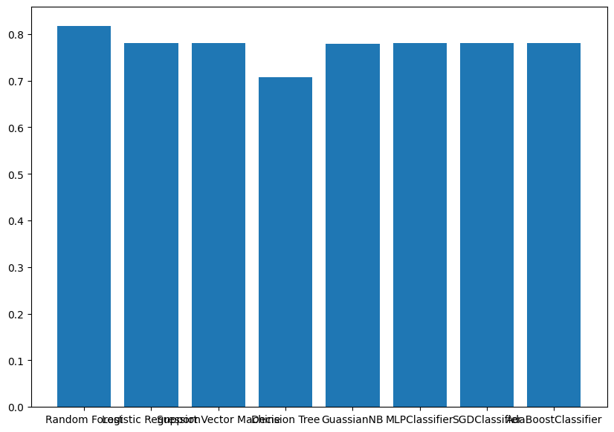
Prediction Performance

Slide 33

Community Contribution
Provide insights about auto theft crime activities for both Oakland/ Los Angeles communities and law enforcement
Law enforcement can allocate resources and officers
Communities can avoid these hot spots for auto theft

Slide 34

Conclusion
Identify trends in automobile crime for potential use in predictive policing
General assumptions regarding location, hourly, daily, and monthly trends were largely consistent across both datasets.
Potential expansion into creating a predictive policing model which can be prove invaluable for law enforcement, aiding in crime prevention and ultimately benefiting potential victims of crime.
Machine Learning Models were able to provide good accuracy for the Oakland Dataset

